Slide 1
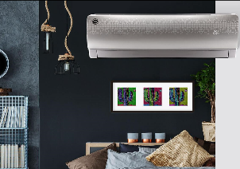
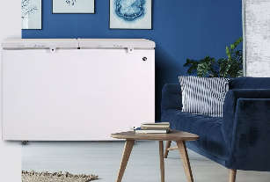
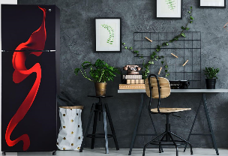

Perfecting Homes For Over 70 Years
There is a PEL in every home

Slide 2
Financial achievement
Key Business Thrusts
PKR Bn | FY 2022 | FY 2023 | FY 2024 | Planned % growth 2024
Gross Sales | 66.0 | 54.3 | 73.9 | 36%
Net Sales | 52.3 | 41.4 | 57.4 | 39%
Gross profit | 10.3 | 10.4 | 15.1 | 45%
Gross profit - % | 19.6% | 25.17% | 27.00% | 7%
Profit from operations | 5.4 | 5.8 | 8.5 | 47%
 |  |  | 14.8% | 6%
Finance cost: | 3.1 | 3.7 | 3 | -19%
% of NSV | 5.9% | 9% | 5.0%
Net Profit Before Tax | 2.3 | 2.1 | 5.5 | 162%
NPBT% | 4.5% | 5.1% | 9.58%
I.Tax | 1.3 | 0.8 | 2.1
PAT | 0.9 | 1.3 | 3.38 | 160%
PAT % | 1.5% | 3.14% | 6.40%
Delivered strong bottom-line despite volume loss due to import restrictions:
2023 PAT% doubled vs. 2022 (3.1% vs. 1.5%) despite
  Approx. 50 % vol reduction in 2023 due to LC limitations
  37% Devaluation that was covered through avg 46% price increase
2024 growing bottom-line ahead of topline ( 2X PAT vs. 39% NSV Inc)
Focused on Cost Optimization:
YOY improvement on margin from operations
Improved margins behind price execution avg 30-40% price increase
Executed fixed cost optimization program to save 0.5Bn across divisions
Business continues to generate cash internally:
Focus on reducing Long-term debt in both division
Despite 10% pts increase in KIBOR finance cost remained almost flat
Optimized working capital by reducing term days
On Track to be long-term debt free in 36 months

Slide 3
Financial health
PKR Bn | 2021 | 2022 | 2023 | 2024 planned
Debt - Total (Dec Closing) | 23.8 | 23.7 | 14.6 | 9.8
WC - Total | 19.1 | 19.9 | 15.9 | 15.2
WC - AD | 12.1 | 11.9 | 7.0 | 8.4
as % of NSV | 49% | 46% | 38% | 27%
WC - PD | 6.9 | 8.0 | 8.8 | 6.8
% of NSV | 39% | 29% | 36% | 25%
Key Business Thrusts
a
Consistent Focus on Long-Term Debt Reduction :
On track to reduce debt by 2/3rd in 2024 vs. 2021
Optimizing Cash Flow:
Reduced WC across both business divisions behind new-policy terms, already implemented in 2023 and will have full year dividends in 2024

Slide 4
Business unit overview
Key Drivers For Power Division
Expansion Of Distribution Network:
Increase focus by government to bring efficiency in distribution network
  Consistent order stream 5-7% vol increase YOY
PKR Bn | Power Division |  |  | Appliance Division
 | 2022 | 2023 | 2024 | 2022 | 2023 | 2024
Gross Sales | 31.8 | 27.4 | 29.8 | 34.2 | 25.2 | 44.1
Net Sales | 27.2 | 22.8 | 25.3 | 25.1 | 18.6 | 32.1
Gross profit | 5.2 | 5.4 | 6.325 | 5.0 | 4.9 | 8.8
Gross profit - % | 19.1% | 23.83% | 25% | 19.9% | 26.82% | 27.00%
Profit from operations | 2.6 | 3 | 3.3 | 2.7 | 2.7 | 5.2
Finance cost: | 1.7 | 1.7 | 1.4 | 1.3 | 1.9 | 1.6
% of NSV | 4.4% | 7% | 5.50% | 5.1% | 10% | 5%
Net Profit before tax | 0.9 | 1.3 | 1.9 | 1.4 | 0.8 | 3.6
Net Profit before tax % | 3.30% | 5.84% | 7.51% | 5.5% | 4.32% | 11.21%
Continue to lead on cost to remain market leader:
Improve Cash conversion cycle by
  Reduced Credit Day from 37 Days (2021) to 24 Days
  Reduced Inventory Days from 80 Days (2021) to 53 Days
Key Drivers For Appliances Division
Maintain Share in stable categories and grow in growth categories:
Despite 50% vol loss due to Forex limitation business was bottom positive
Aggressive pricing avg 40% vs. 2022 enable operating margin recovery
Streamline Dealership and Supply Chain network:
YOY improvement on margin from operations
  Reduced Credit Day from 126 Days to 83 Days
  Reduced Inventory Days from 128 Days 119 Days

Slide 5


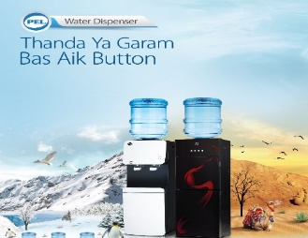
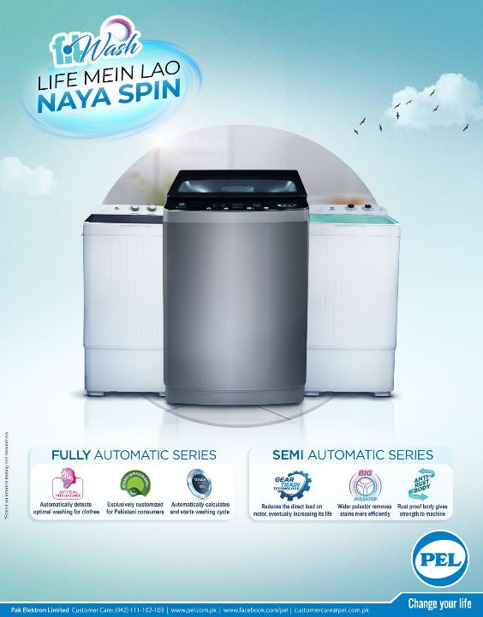

Appliance Opportunity: Lowest penetration regionally creates opportunity to grow
Continue to aggressively maintain 3rd position in a over 400BN Industry – that is posed to grow!
Maintain Market Share in improve margin through premiumization
Growth Opportunity and shield seasonality
PEL Share 20%
PEL Share 08%
PEL Share 33%
PEL Share 04%
PEL Share 03%
Refrigerator & Freezer
Air Conditioner
Water Dispenser
Washing Machine
LED
Volume Size :
1.9 Million Units / Yr
Volume Size :
1.2 Million Units / Yr
Volume Size :
0.2 Million Units / Yr
Volume Size :
1.9 Million Units / Yr
Volume Size :
0.9 Million Units / Yr
Penetration :
54%
Penetration :
14%
Penetration :
5%
Penetration :
65%
Penetration :
73%
Avg Life :
10 Yrs
Avg Life :
06 Yrs
Avg Life :
08 Yrs
Avg Life :
10 Yrs
Avg Life :
04 Yrs
 | 2022 | 2023 | 2024
Avg Px | 42,423 | 62,142 | 72,514
Avg Px Inc | 22.8% | 46.5% | 16.7%
MKT Size | 80.6 | 118.0 | 137.7
MM % | 28.7% | 39.0% | 39.2%
 | 2022 | 2023 | 2024
Avg Px | 84,350 | 112,920 | 145,170
Avg Px Inc | 30.8% | 33.9% | 28.6%
MKT Size | 101.2 | 135.5 | 174.2
MM % | 22.1% | 27.8% | 28.6%
 | 2022 | 2023 | 2024
Avg Px | 20,269 | 26,095 | 34,846
Avg Px Inc | 23.7% | 28.7% | 33.5%
MKT Size | 38.5 | 49.5 | 66.2
MM % | 24.2% | 31.8% | 32.0%
 | 2022 | 2023 | 2024
Avg Px | 17,752 | 25,018 | 30,395
Avg Px Inc | 20.7% | 40.9% | 21.5%
MKT Size | 3.5 | 5.0 | 6.0
MM % | 21.2% | 28.1% | 28.3%
 | 2022 | 2023 | 2024
Avg Px | 29,020 | 35,681 | 50,956
Avg Px Inc | 8.0% | 23.0% | 42.8%
MKT Size | 26.1 | 32.1 | 45.8
MM % | 18.6% | 23.8% | 24.4%
Drive pricing ahead of cost as to ensure consistent margin improvement across portfolio
Source: IPSOS Consumer Book Pakistan 2021, Market Price , Consumer U&A
Avg Px are NSV and MKT Size in PKR Billion
Notes:
Penetration grows – 10% in 5 years
Volume growth
Value growth
PEL maintain share – annual vol/val growth

Slide 6
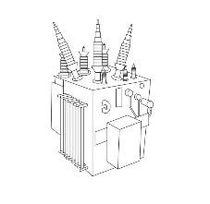
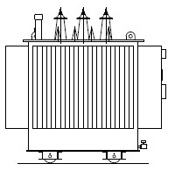
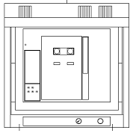
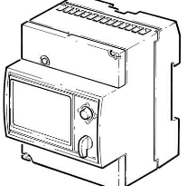
Power Opportunity: Stable business and endowered with natural barrier to entry
Continue to aggressively maintain market leadership and drive margin through timely pricing actions
Power Transformer
Distribution Transformer
Switch Gear
Energy Meter
Volume Size :
70 Units / Yr
Volume Size :
50,000 Units / Yr
Volume Size :
3 Million Units / Yr
Volume Size :
3.0 Million Units / Yr
 | 2022 | 2023 | 2024
Avg Px | 99 M | 193 M | 228 M
Avg Px Inc | 30.3% | 95.1% | 18.2%
MKT Size | 11.01 | 10.09 | 11.16
MM % | 30.1% | 36.2% | 38.0%
 | 2022 | 2023 | 2024
Avg Px | 379.8K | 594.1K | 663.9K
Avg Px Inc | 58.9% | 56.4% | 11.7%
MKT Size | 48.10 | 57.89 | 64.83
MM % | 24.4% | 32.5% | 33.5%
 | 2022 | 2023 | 2024
Avg Px | 2.10 M | 2.17 M | 2.50 M
Avg Px Inc | 39.4% | 3.2% | 15.0%
MKT Size | 11.03 | 8.25 | 9.49
MM % | 23.7% | 32.5% | 36.0%
 | 2022 | 2023 | 2024
Avg Px | 2.1K | 5.6K | 6.7K
Avg Px Inc | 91.6% | 161.0% | 18.6%
MKT Size | 13.33 | 28.90 | 34.39
MM % | 29.0% | 50.4% | 56.0%
Maintain market leadership and drive internal efficiency to remain cost competitive
Notes:
Penetration grows – 10% in 5 years
Volume growth
Value growth
PEL maintain share – annual vol/val growth

Slide 7
Perfecting Homes For Over 70 Years
Thank You

Slide 8
Disclaimer
The financials number in this presentation may vary subject to change in financial conditions/policies in the country

